Slide 1
SEVERITY OF DIABETIC RETINOPATHY USING DEEP LEARNING
Under The Guidance Of
Dr. Kamalakar Ramineni
Department of Computer Science And Engineering

Slide 2
TEAM MEMBERS:
2003A51058 - Kudikilla Karthik
2003A51169 - Lakum Rohith
2003A51290 - Naini Nithya Reddy
2003A51219 - Dusari Aravind
2003A51187 - Shetty Sri Charan

Slide 3
ABSTRACT
The human eye is considered as the most important sense organ. Some of the eye problems may be curable but few may lead to permanent loss of vision. Commonly occurring diseases such as optic nerve disorder such as Glaucoma, destruction of sharp vision such as Age-Related Macular Degeneration(ARMD), diabetic eye problems like retinopathy etc. This project focuses on detection of Diabetic Retinopathy

Slide 4
PROBLEM IDENTIFICATION
Traditional methods of DR detection involve manual examination of retinal images by trained ophthalmologists, which is time-consuming and resource-intensive.
This project aims to develop an automated system for the detection of diabetic retinopathy using advanced image processing and Machine Learning techniques.

Slide 5
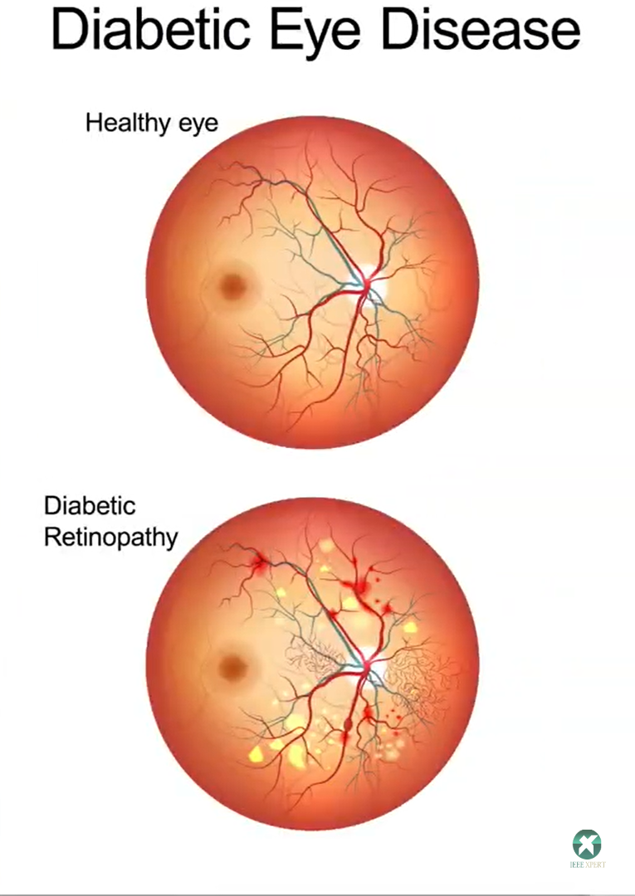
Fig 1.1: Difference between Normal Retina and Diabetic Retinopathy Retina

Slide 6
Different stages of Diabetic Retinopathy
Mild non-proliferative retinopathy
Moderate non-proliferative retinopathy
Severe non-proliferative retinopathy
Proliferative diabetic retinopathy (PDR)

Slide 7
EXISISTING VS PROPOSED SYSTEM
1.Time Constraints :
Existing systems manual examination process may be time-consuming,leading to delays in diagnosis and treatment initiation
Proposed System significantly reduces time constraints by automating the detection process , allowing for faster analysis
2.Scalability :
Existing system may encounter limitations in handling a large volume of patients due to processing constraints .
Proposed system offers greater scalability,accommodating a larger number of individual without significant performance degradation

Slide 8
3.Cost Efficiency :
Existing system may incur high costs associated with manual examination and specialized equipment
Proposed system offers a cost-effective solution by automating the detection process,reducing the need for manual labr and expensive equipment
4.Accessibility:
Existing systems might have limited accessibility, especially in remote or underserved areas, due to the requirement of specialized equipment or expertise.Proposed system improves accessibility by providing a more widely available solution that can be deployed in various healthcare settings, including areas with limited resources or expertise, thereby increasing the reach and impact of diabetic retinopathy screening and diagnosis.

Slide 9
TECHNOLOGY USED
Convolutional Neural Networks (CNNs), a branch of deep learning, have an impressive record for applications in image analysis and interpretation, including medical imaging. Network architectures designed to work with image data.
The key algorithms utilized include deep convolutional neural networks (ResNet), data augmentation, and hyperparameter tuning.

Slide 10
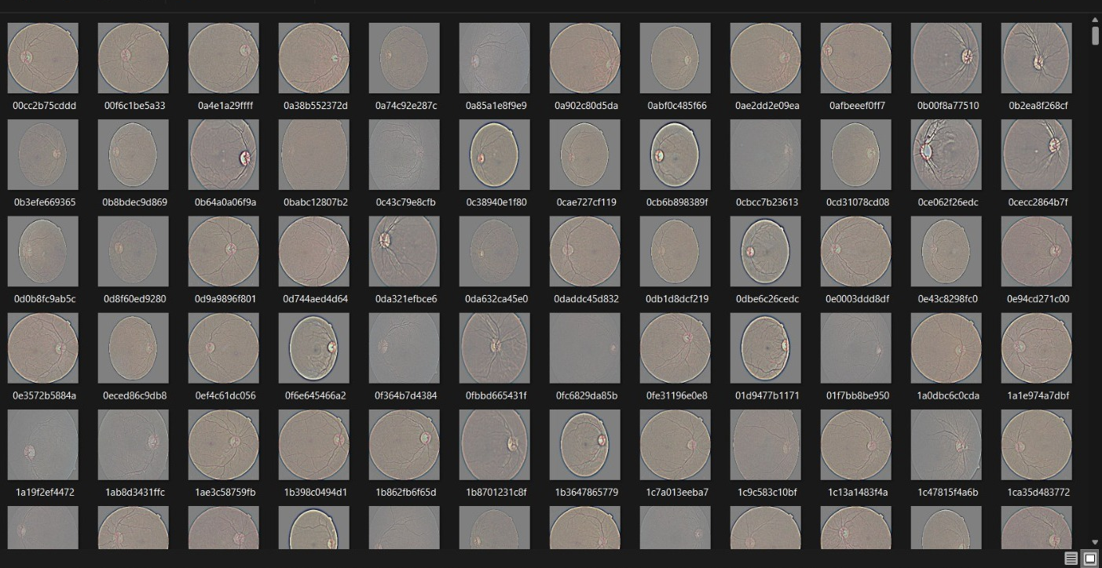
DATA SET

Slide 11
LITERATURE REVIEW
Identify Keywords: Begin by identifying a set of keywords and phrases closely related to the project, such as Detection of Diabetic Retinopathy, Proliferative, Non-proliferative etc. These keywords will serve as the basis for conducting your literature search.
Search Databases: Utilize academic databases like IEEE Xplore to search for research papers and articles relevant to your project's focus.
Review Abstracts: Thoroughly examine the abstracts of the identified papers to gain an overview of the research work. Based on the abstracts, shortlist papers that appear directly relevant to the Detection of Diabetic Retinopathy. This step will help you to focus on the most relevant research.

Slide 12
Compare Methodologies: Analyze the various methodologies and techniques used in the literature for Detection of Diabetic Retinopathy. Compare the pros and cons of different approaches, such as deep learning-based methods (CNNs), traditional image processing techniques, and hybrid models, to determine the most suitable approach for your project.
Consider Data: Pay attention to the datasets utilized in the reviewed literature. Evaluate the size, diversity, and relevance of the datasets to your specific detection of diabetic retinopathy. Consider whether the datasets cover variations in lighting conditions
Note Innovations: Take note of any innovative techniques, enhancements, or novel ideas presented in the literature. These innovations can provide valuable insights and creative solutions to enhance our proposed System.

Slide 13
LINKS
https://www.aoa.org/healthy-eyes/eye-and-vision-conditions/diabetic-retinopathy?sso=y
https://www.nei.nih.gov/learn-about-eye-health/outreach-campaigns-and-resources/eye-health-data-and-statistics/diabetic-retinopathy-data-and-statistics
https://www.sightsavers.org/blogs/2021/06/diabetic-retinopathy-in-pakistan/

Slide 14
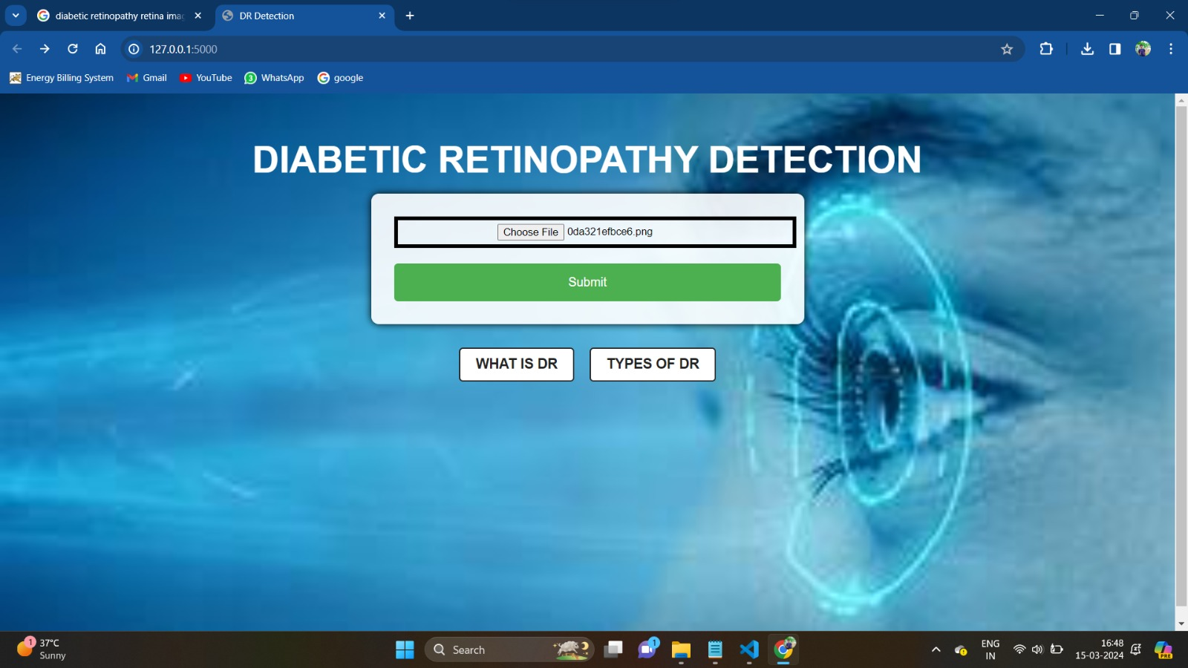
INTERFACE OF THE PROJECT

Slide 15
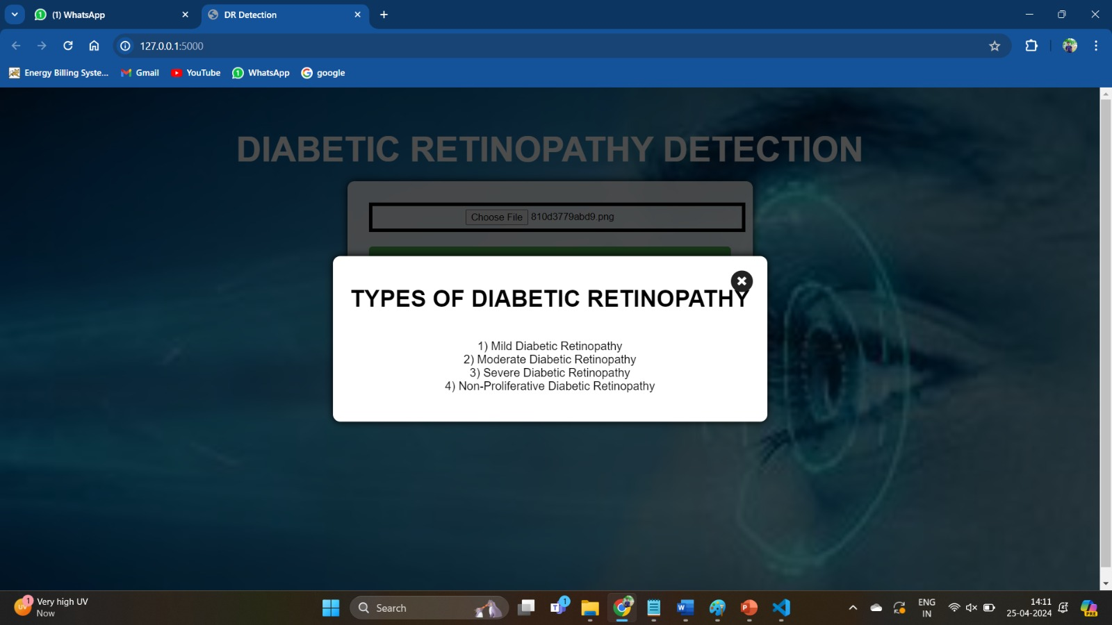

Slide 16
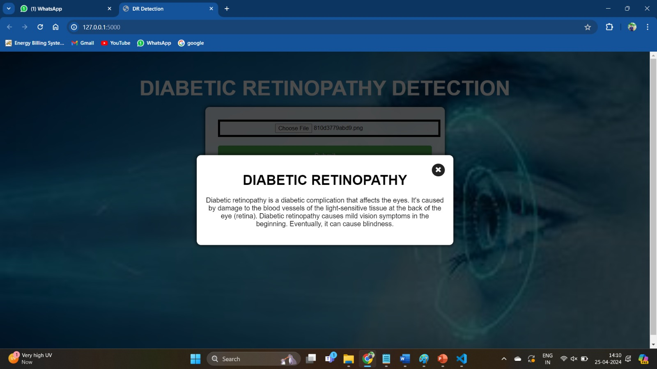

Slide 17
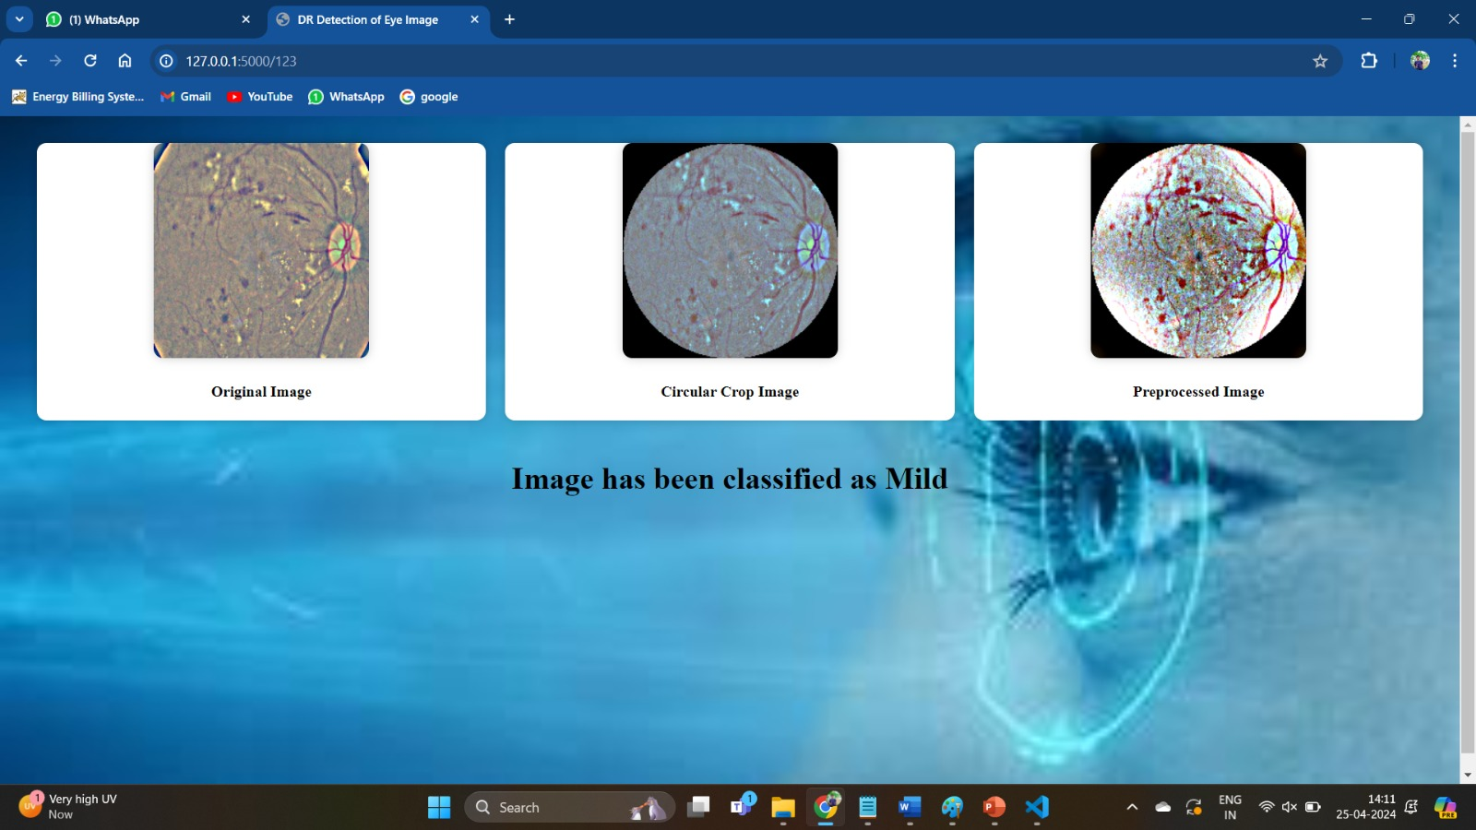

Slide 18
Thank you !

